Slide 1
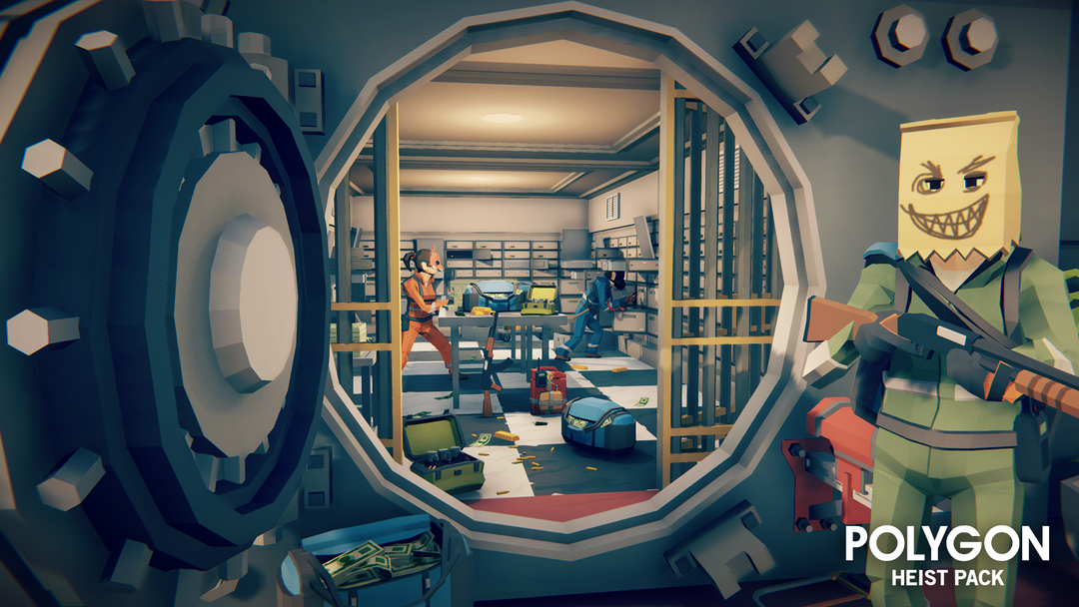
Heist of Reckoning
By Ethan, Matthius and Paul

Slide 2

Themes and gameplay
Themes: Platformer, RPG, Stealth
Core gameplay: Get to the getaway vehicle while escaping the police

Slide 3
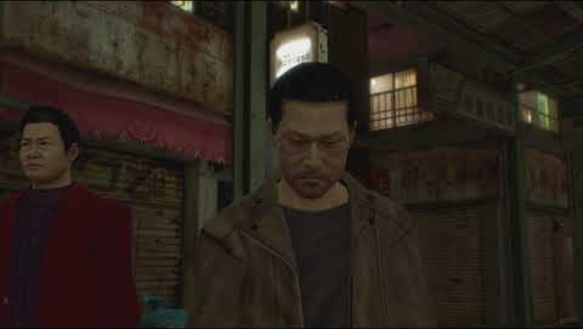
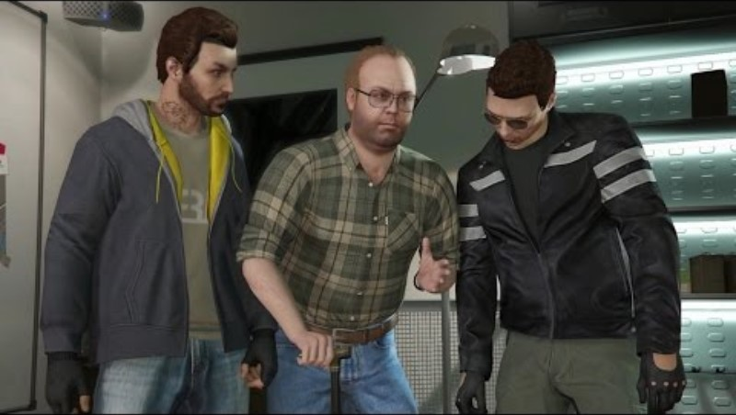
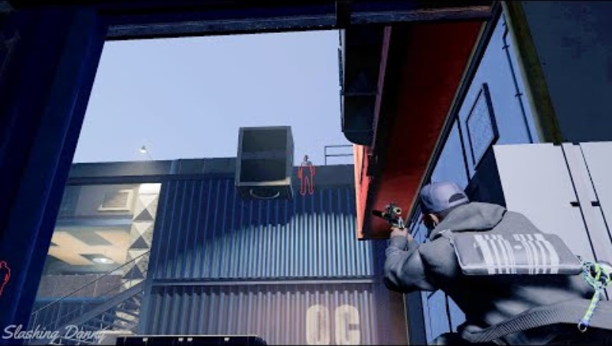
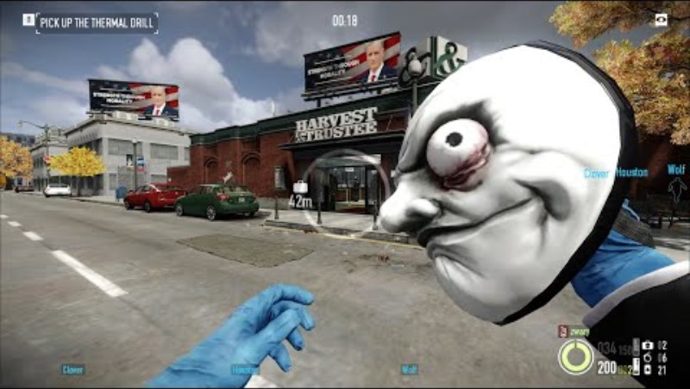
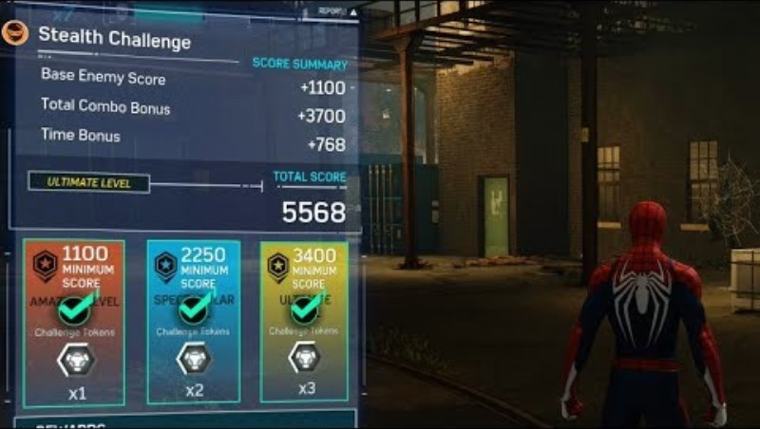
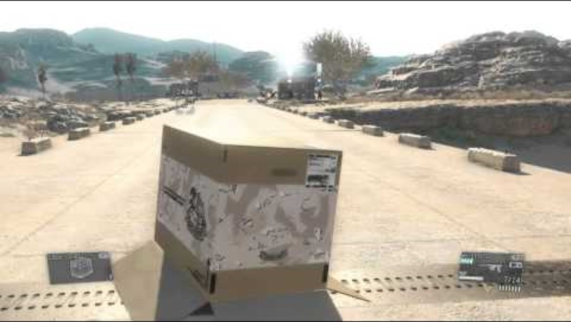
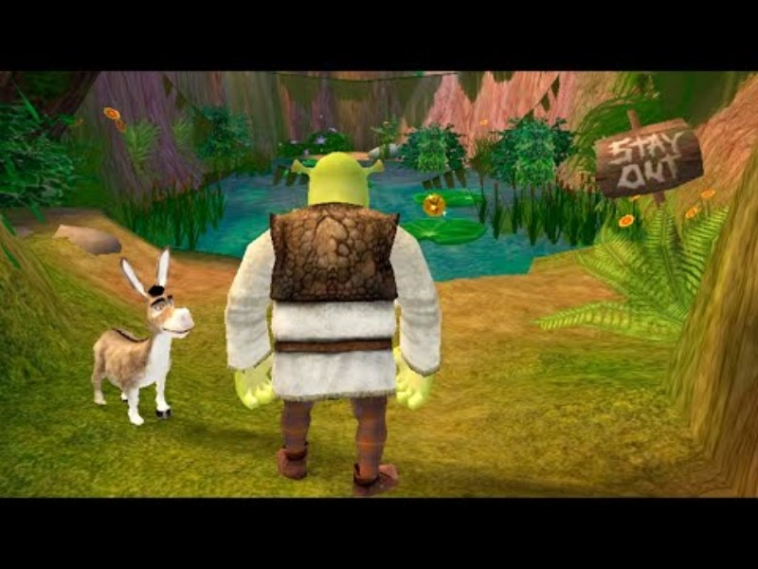

Inspiration
Video 1 - Yakuza 0
Video 4 – GTA 5
Video 7 – Watch dogs 2
Video 2 - Payday
Video 5 – Spiderman 2019
Video 8 – Metal gear 5
Video 3 – Shrek 2
Video 6 – Batman Arkham knight

Slide 4
Game Mechanics
Difficulty (Change the time of day)
Different routes (Building, Sewers)
Local Multiplayer

Slide 5
Player Abilities
Throw money (Attract civilians to the area)
Disable camera (Hide from view)
Hide in box (to avoid camera)

Slide 6
NPCs
Police -
Helicopter Police
Civilians

Slide 7
Graphics

Slide 8

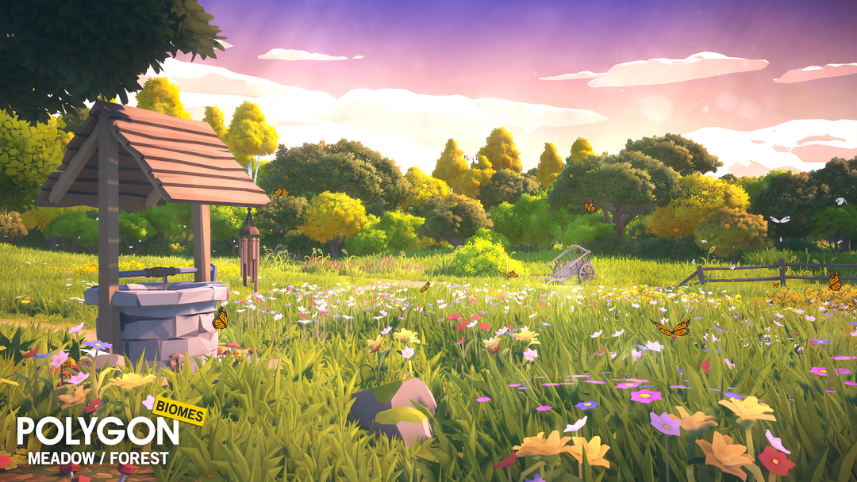
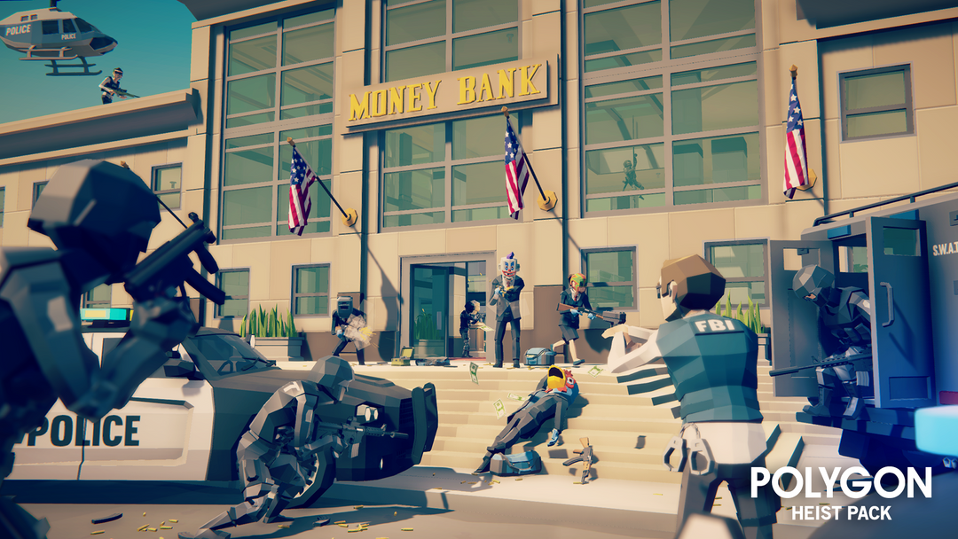

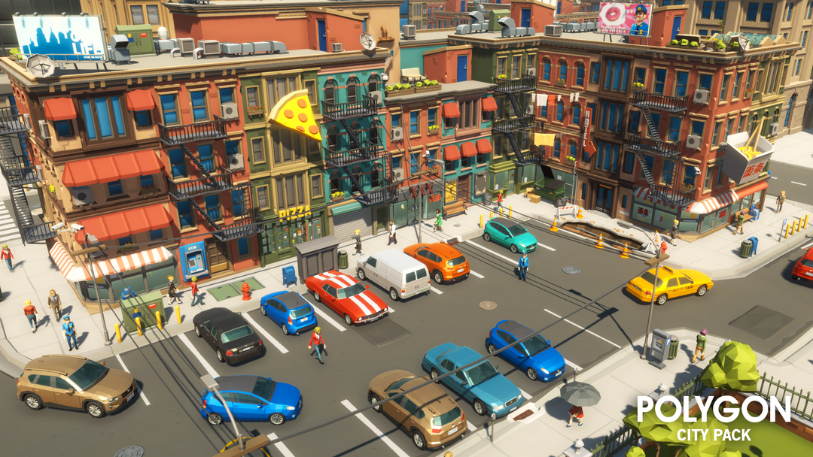
Assets
Figure 2 - ‌Synty Store. (n.d.). POLYGON - Heist Pack Game Assets - Find the Unity Asset in Store. [online] Available at: https://syntystore.com/en-gb/products/polygon-heist-pack?_pos=1&_psq=heist&_ss=e&_v=1.0 [Accessed 2 Feb. 2024].
Figure 3 - Synty Store. (n.d.). Simple Sky Cartoon Assets | Free Low-Poly Game Assets. [online] Available at: https://syntystore.com/en-gb/products/simple-sky-cartoon-assets?_pos=1&_psq=sky&_ss=e&_v=1.0 [Accessed 2 Feb. 2024].
Figure 4 - ‌Synty Store. (n.d.). POLYGON - Icons Pack Game Assets - Find the Unity Asset in Store. [online] Available at: https://syntystore.com/en-gb/products/polygon-icons-pack?_pos=1&_psq=icon&_ss=e&_v=1.0 [Accessed 2 Feb. 2024].
Figure 1 - ‌Synty Store. (n.d.). POLYGON - Nature Biomes - Season One Game Assets - Find the Unity Asset in Store. [online] Available at: https://syntystore.com/en-gb/products/polygon-nature-biomes-season-one?_pos=1&_psq=nature&_ss=e&_v=1.0 [Accessed 2 Feb. 2024].
Figure 5 - ‌Synty Store. (n.d.). POLYGON | City Pack Game Assets | SyntyTM Official Store. [online] Available at: https://syntystore.com/en-gb/products/polygon-city-pack?_pos=1&_psq=city&_ss=e&_v=1.0 [Accessed 2 Feb. 2024].

Slide 9
Controller features

Slide 10
Development order

Slide 11
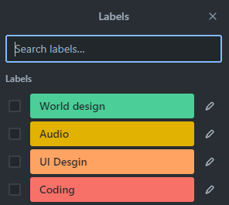
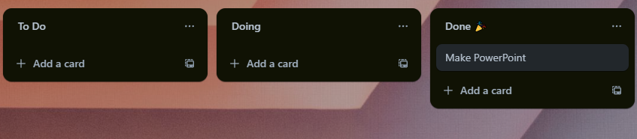
Breakdown of workload
Using Trello for Kanban
Allowing us to assign ourselves to tasks
Using labels to keep tasks clear

Slide 12
What if it goes wrong

Slide 13
Planned features for prototype

Slide 14
Thanks for listening

